Slide 1
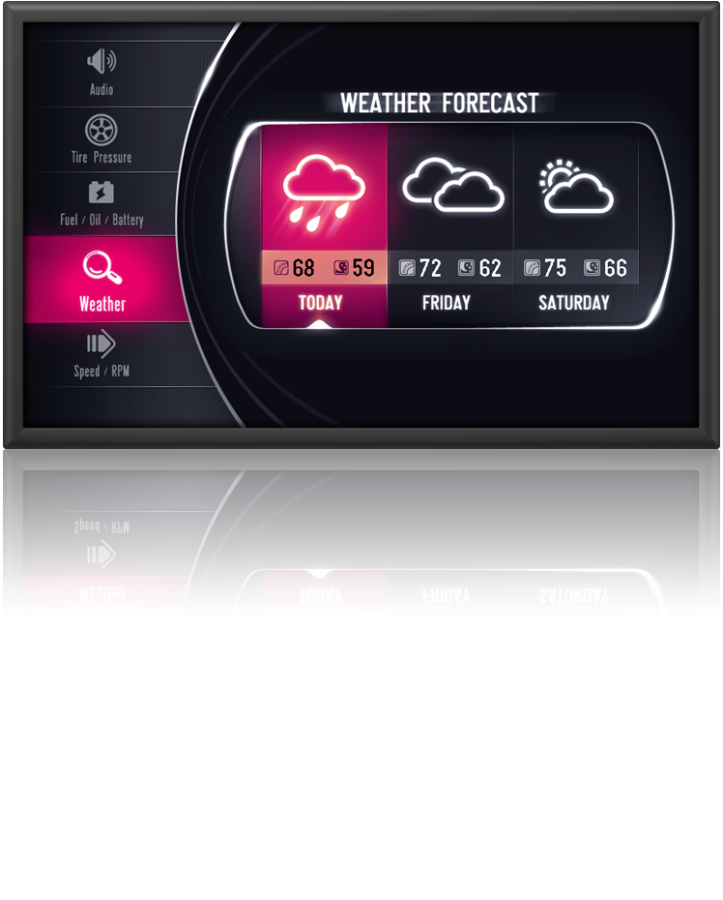

Altia tools can generate user interface code for Altera hardware.
Altia® DeepScreen® can target GUIs created in Altia® Design to a simple frame buffer on Nios II hardware or to the D/AVE accelerated graphics API offered by TES. With these options, it is possible to get outstanding graphics performance for next generation GUIs on the lowest cost hardware.
For more information about Altia, visit www.altia.com or contact:
Peter Abowd (Automotive Applications)
+1 248 921-4782 or petera@altia.com
Paul De Curnou (Medical, Consumer and Other Applications)
+1 303 554-0713 or pauld@altia.com

Slide 2




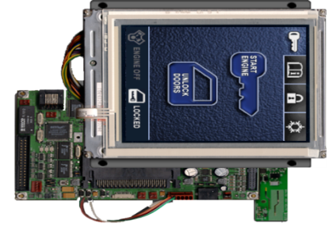
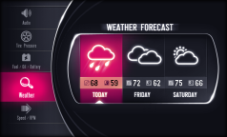
Altia’s Purpose
Get a custom HMI design from the Artist’s imagination to
the lowest cost hardware in the shortest amount of time.
Prototype
(with PhotoShop® and PhotoProtoTM)
Design
(with Altia® Design)
Generate Code
(with DeepScreen® Graphics Code Generator)

Slide 3
Altia Advantages
• Includes Designers and Artists in the process
High impact user interfaces get your products noticed.
• High performance C code output
Generated graphics code leverages the power of FPGAs and the D/AVE engine.
• Portability across multiple targets
Altia interfaces built for other targets can be rapidly moved to an FPGA for performance testing.
• Standard and open data formats
Altia’s use of Photoshop®, bitmaps, XML and C minimizes the risk of using tools.

Slide 4
More Information
Altia tools can be used to generate user interface code for any Cyclone or Stratix device with Nios-II soft core using:
  A software-based rendering solution which uses only the Nios II processor for graphical operations
  The hardware-based D/AVE accelerated graphics API offered by TES
Demos of each of these solutions can be downloaded at http://www.altia.com/altera.php.
For more information about Altia, visit www.altia.com or contact:
Peter Abowd
(Automotive Applications)
+1 248 921-4782 petera@altia.com
Paul De Curnou
(Medical, Consumer and Other Applications)
+1 303 554-0713
pauld@altia.com

